Slide 1
FYP Interim Review
Mas Khairul Amir (214199Y)
Ryan (210731E)

Slide 2
Contents
01
02
03
04
Objectives
Main Features
Discuss the main objectives of the project
Describe the main features
Allocated Tasks
Demo
Share our individual work progress from week 1 - 6

Slide 3

01
Main Objectives

Slide 4
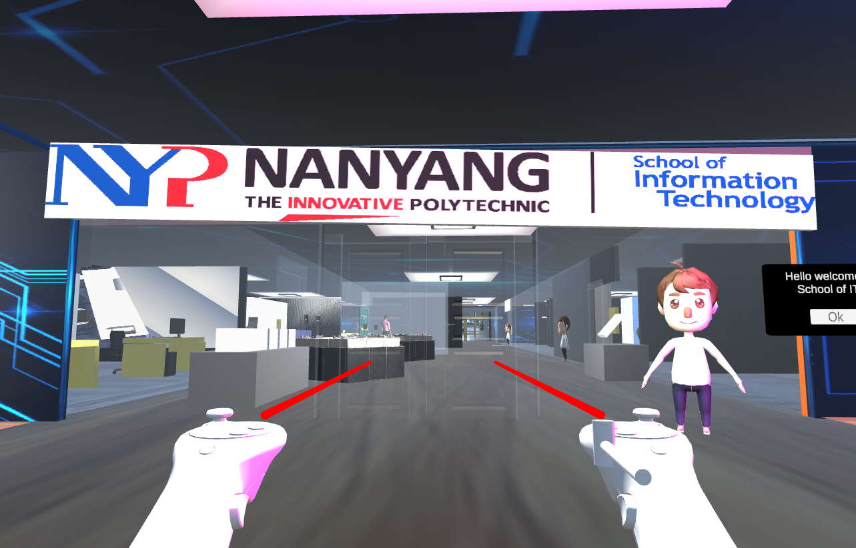
Main Objectives
Create a metaverse for Centre for IT Innovation(CITI) - CITI Land
Create a fun and interactive experience
Able to explore and try different features while using the Oculus Headset

Slide 5
02
Main Features

Slide 6
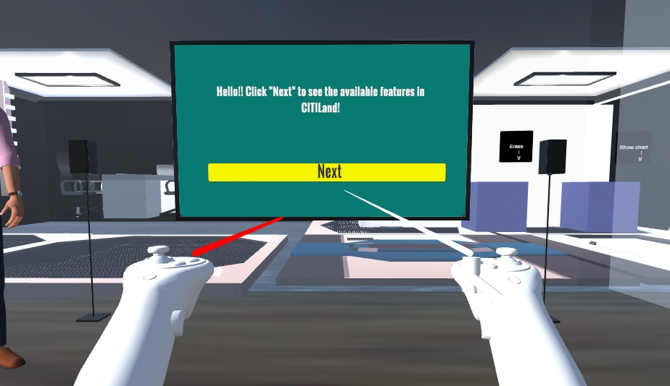
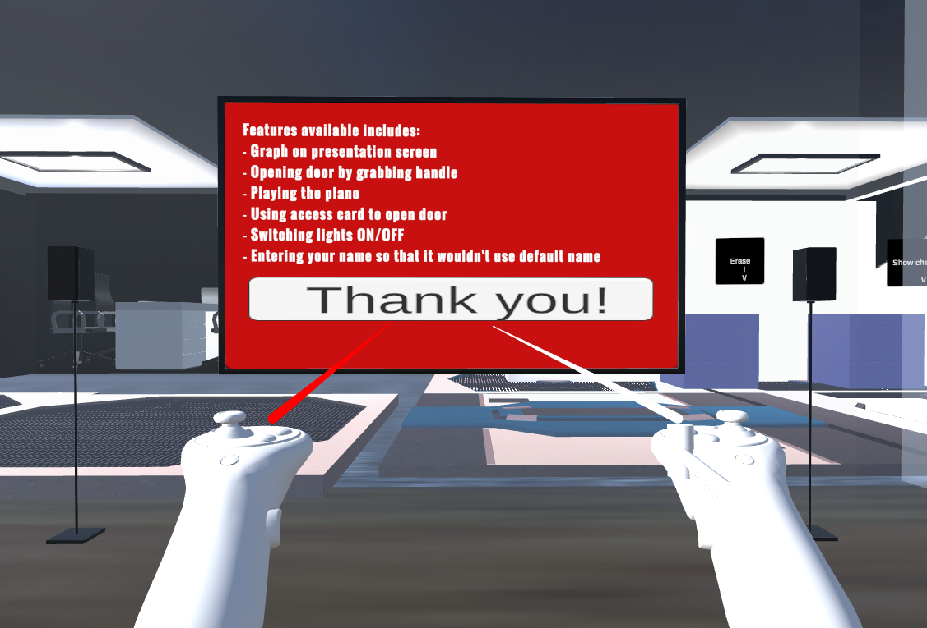
Main Features (Presentation Room)
Interactive presentation screen

Slide 7
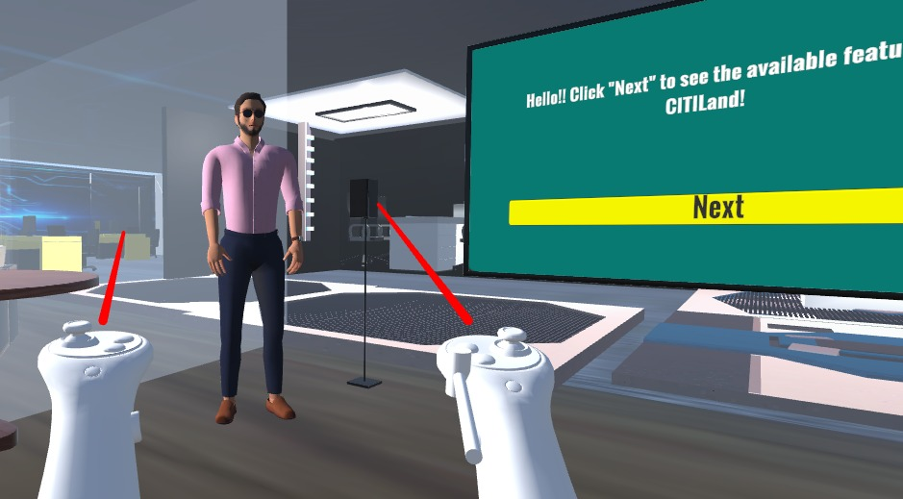
Main Features (Presentation Room)
Non-Player Character (NPC) as Presenter/Speaker
Click for audio

Slide 8
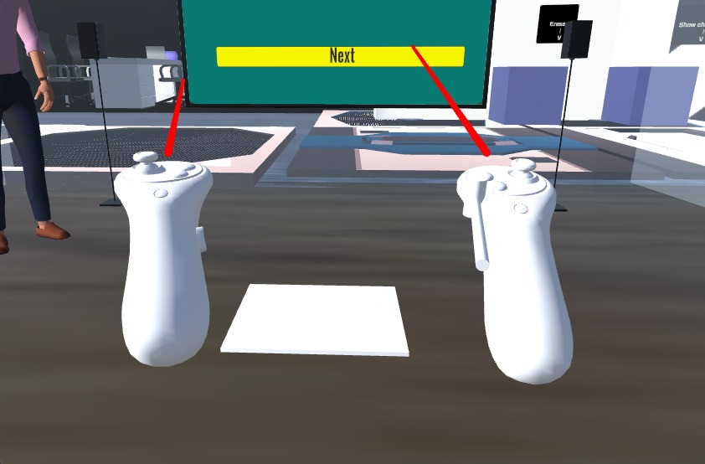
Main Features (Presentation Room)
Audio Trigger Tile

Slide 9
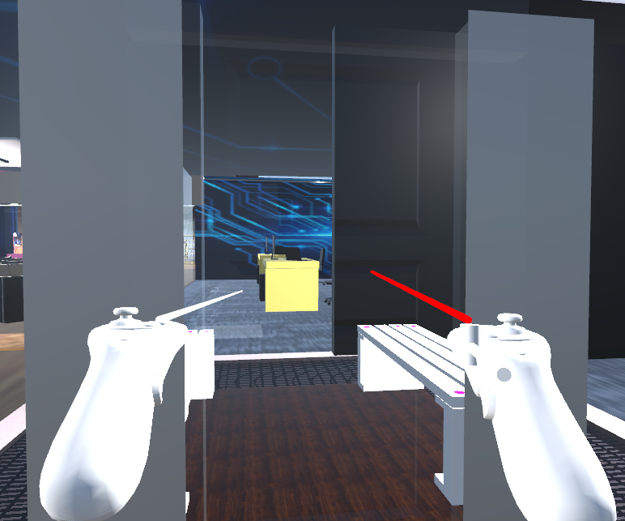
Main Features
Closed door which has an interactive handle

Slide 10
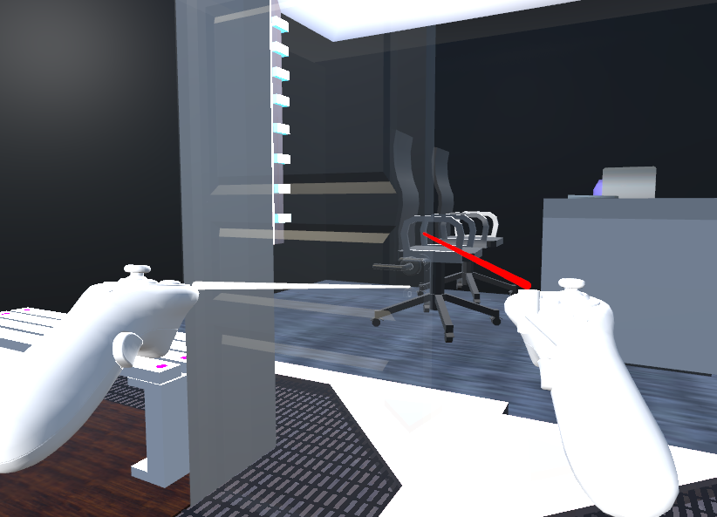
Main Features
Upon clicking on handle, door can be swung open

Slide 11
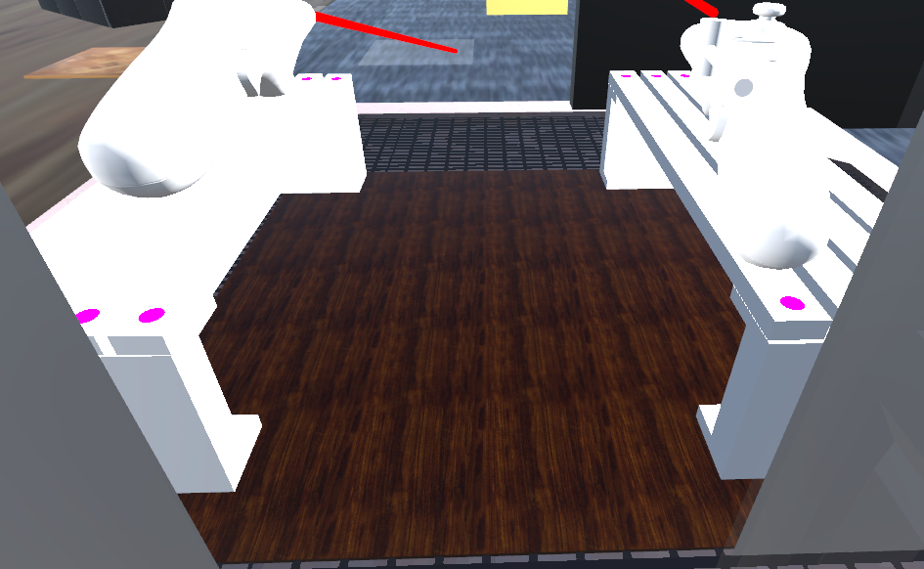
Main Features
Audio Trigger Floor where music can be played upon standing on it

Slide 12
03
Allocated Tasks

Slide 13
Week 1-6 (Presentation Room)
What’s Next?
Explore asset store
Added a TV Screen, 2 Speakers
Tried different NPCs
Research on Text-to-speech
Different ways of adding audio (different audio triggers functions)
Implement audio into NPC (click using Mouse)
Implement collider on Tile (tried different ways to trigger audio)
Trigger when player collides with the layer the tile is on
Allowing visitors to stop the NPC’s audio (Click on NPC again)
Allowing developers to edit the text-to-speech directly through the code

Slide 14
Week 1-6 ( Study Pod )
Exploring features of unity hub and unity asset stores
Create a study pod with different methods like blender, probuilder etc
Made a door with an interactive handle to handle opening and closing
Tested multiple benches to find most suited
Research on Audio Source for play
Create a floor where music can be played once stepped upon and stopped once stepped off
Research on Sit Function for bench
Create a sit controller for bench so players can interact with a keybind to sit

Slide 15
04
Demo

Slide 16
Thanks

